Slide 1
Autopilot Control of MQ-9
University of Southern Denmark
shkum20@student.sdu.dk

Slide 2
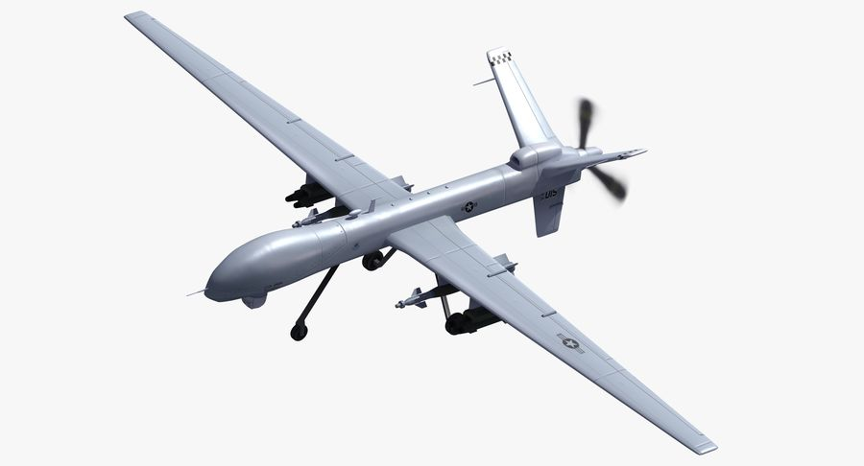
Agenda
About MQ9 Fixed-Wing Drone
Flight Dynamics
Longitudinal Autopilot
Lateral Autopilot
Autonomous Mission
Overall System
Results

Slide 3
About MQ-9 Fixed-Wing Drone
General Atomics MQ-9 Reaper also called as Predator B is an unmanned aerial vehicle capable of remotely controlled or autonomous flight operations
Maximum speed: 400 km/h (240 knots)
Range: 1900 km (1000 nautical miles)
Wingspan: 20m
Length: 11m
Cost: $56.5 million – includes 4 cameras with sensors, ground control stations and satellite connection.

Slide 4
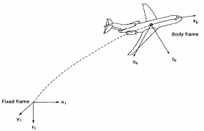
Flight Dynamics
Newton’s Law for Translation and Rotation.
Velocities [U V W] point along [X Y Z]
Moments [L M N] i.e. [ Roll Pitch Yaw]
Relation between earth frame and body frame
Directional Cosine Matrix : A transformation matrix that transforms one coordinate reference frame to another.
Notes:
States that the summation of forces and moments acting on the aircraft is equal to the rate of change in linear momentum and angular momentums.
Aircraft flight path, it is necessary to mention the reference axis system of the aircraft and its relation to the Earth

Slide 5
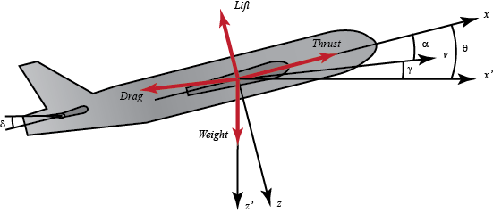
Longitudinal Autopilot
The longitudinal autopilot is responsible of maintaining the desired aircraft speed, climb angle and hence altitude by outputting the required elevator and thrust control actions.

Slide 6
Subparts : Longitudinal Autopilot
Pitch Controller
The elevator controls pitch. On the horizontal tail surface, the elevator tilts up or down, decreasing or increasing lift on the tail. This tilts the nose of the airplane up and down.
Altitude Controller
Hold the aircraft altitude
Pitch from altitude- calculates the required pitch angle based on the error between the current and desired altitude.
Velocity Controller
At critical angle 𝜃 show the aircraft climbs but later starts to dive downwards as the climb angle changes from +ve to –ve stall condition.
γ = θ − α
Notes:
Pitch rate feedback effect is that the pitch rate feedback provides little bit damping effect on phugoid mode.
If the velocity of aircraft is maintained by separate control system, the changes in the angle of attack gets arrested as a result the flight path angle and pitch angle of aircraft gets easily controlled by the elevator input. (Flight path angle = Pitch angle – Angle of attack);; "trim" an aircraft is to adjust the aerodynamic forces on the control surfaces so that the aircraft maintains the set attitude without any control input.

Slide 7
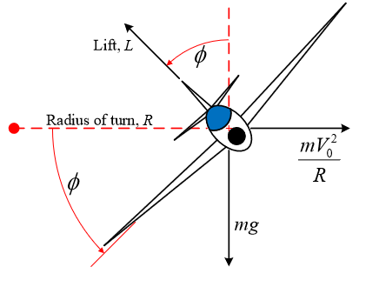
Lateral Autopilot
Lateral autopilot as a steady coordinated turn must be performed. A steady coordinated level turn means that the aircraft is kept at a constant altitude-controlled by the longitudinal autopilot- with no side slip while turning.
Notes:
The aircraft is turned through the action of the side component of the lift force. The rudder is used during the turn to coordinate the turn, i.e. to keep the nose of the aircraft pointed along the flight path. If the rudder is not used, one can encounter an adverse yaw in which the drag on the outer wing pulls the aircraft nose away from the flight path.

Slide 8
Subparts : Lateral Autopilot
Yaw Damper
A yaw damper is a system used to reduce or damp the undesirable tendencies of an aircraft to oscillate in a repetitive rolling and yawing motion, a phenomenon known as the Dutch roll
Roll Controller
It’s to reach a desired bank angle.
Not exceed maximum aileron deflection, i.e., sum of the two aileron deflections and maximum bank angle.
Coordination Turn
Coordination requires zero lateral acceleration.The required bank angle can be obtained for a given speed and turning rate
Turning rate is obtained as :𝜓̇ = (𝜓𝑑 − 𝜓)
Notes:
Yaw Damper :: solution for this problem is to use a high pass ﬁlter in the system controller to act as a high pass filter that eliminates the low frequency signal and only feeds back the high frequency signal to the controller.

Slide 9
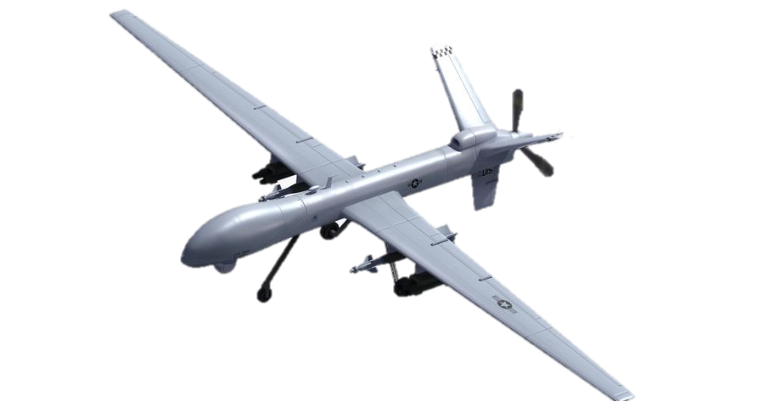
Autonomous Mission
Climb to altitude of 10,000 𝑓𝑡
Cruise at constant velocity and heading angle for 2 𝑚𝑖𝑛𝑢𝑡𝑒𝑠
Make a circle by commanding a change in the heading angle with 360° turn
Cruise at constant velocity and heading angle for 2 𝑚𝑖𝑛𝑢𝑡𝑒𝑠
Climbing by commanding a change in as step input of 100 𝑓𝑡 in altitude
Descend down to the initial altitude by reducing the altitude by 10,000 𝑓𝑡

Slide 10
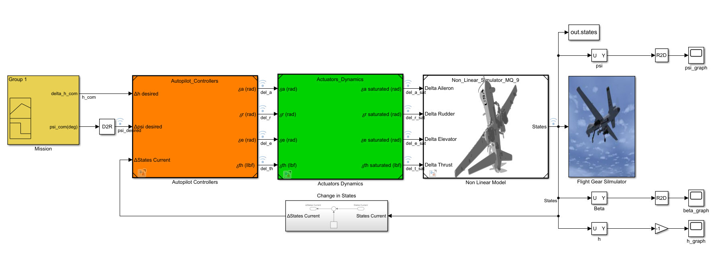
Overall System

Slide 11
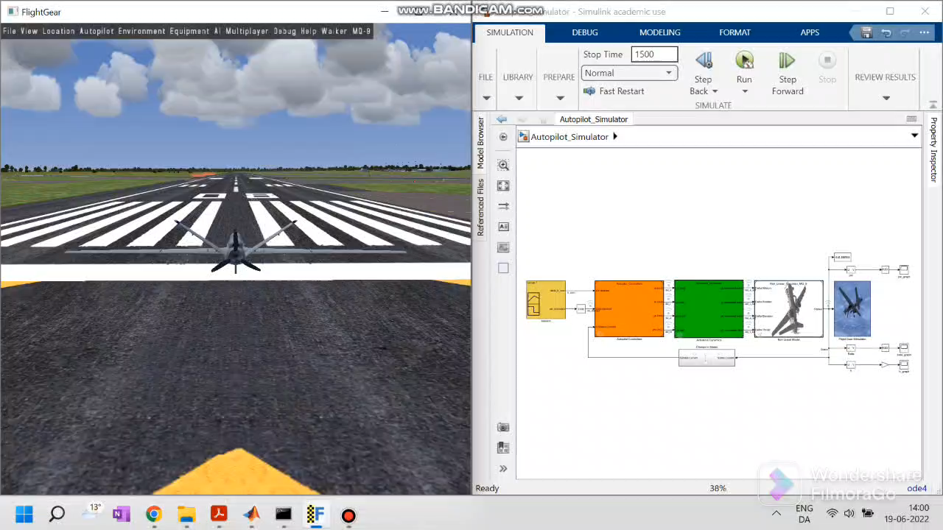
Results

Slide 12
Thank You !
Q&A ?

